Slide 1
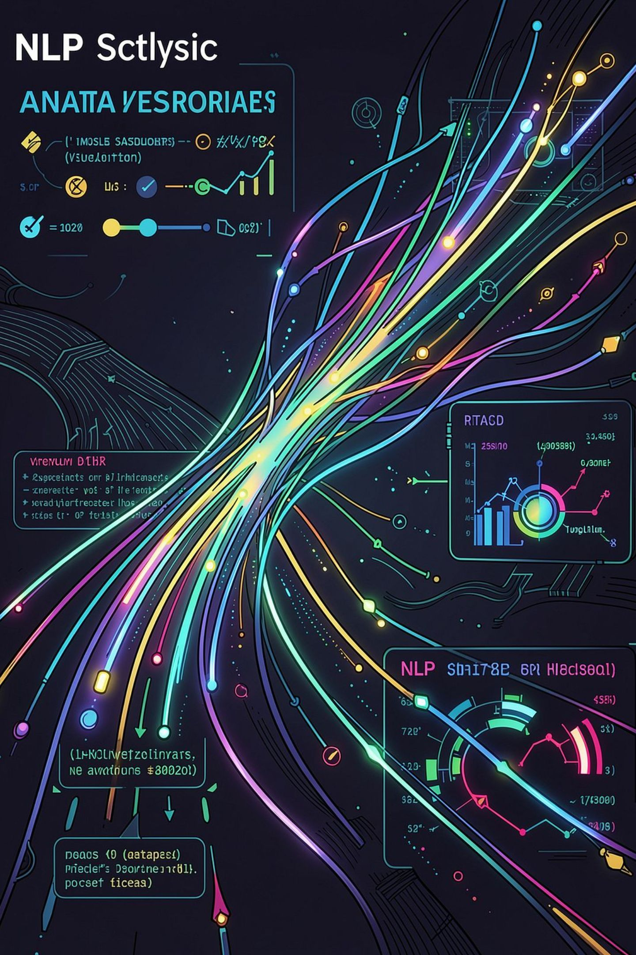
Customer Satisfaction Classification System
Feedback Analysis & Natural Language Processing
AI-POWERED
NLP · MACHINE LEARNING · ANALYTICS

Slide 2

Why Customer Feedback Analysis Matters
In today's competitive landscape, customer feedback is the most direct signal of product quality, service gaps, and brand perception. Organizations that act on feedback systematically retain customers longer and grow faster.
Product Quality
Identify recurring defects and feature requests directly from user reviews
Service Improvement
Pinpoint service failures before they escalate to churn
Brand Reputation
Monitor sentiment across social media, reviews, and support channels
Customer Retention
Proactively address negative experiences to reduce attrition

Slide 3


The Challenge of Manual Feedback Analysis
Modern enterprises collect feedback across dozens of channels — reviews, surveys, social media, emails, chat logs, and support tickets. Manual processing is simply not scalable.
Inconsistent Interpretation
Delayed Decision-Making
Volume Overload
Blind Spots
Human analysts apply subjective judgment, producing unreliable classifications
Manual review cycles take days or weeks, missing real-time opportunities
Thousands of daily reviews cannot be processed by human teams alone
Emerging concerns go undetected until they become critical issues

Slide 4

Proposed Solution: Intelligent Feedback Classification
An end-to-end NLP platform that automatically collects, processes, and classifies customer feedback — delivering real-time satisfaction scores and actionable insights across every channel.
Collect
Analyze
Preprocess
The system operates autonomously at scale, processing thousands of feedback items per minute with consistent, bias-free classification accuracy.

Slide 5
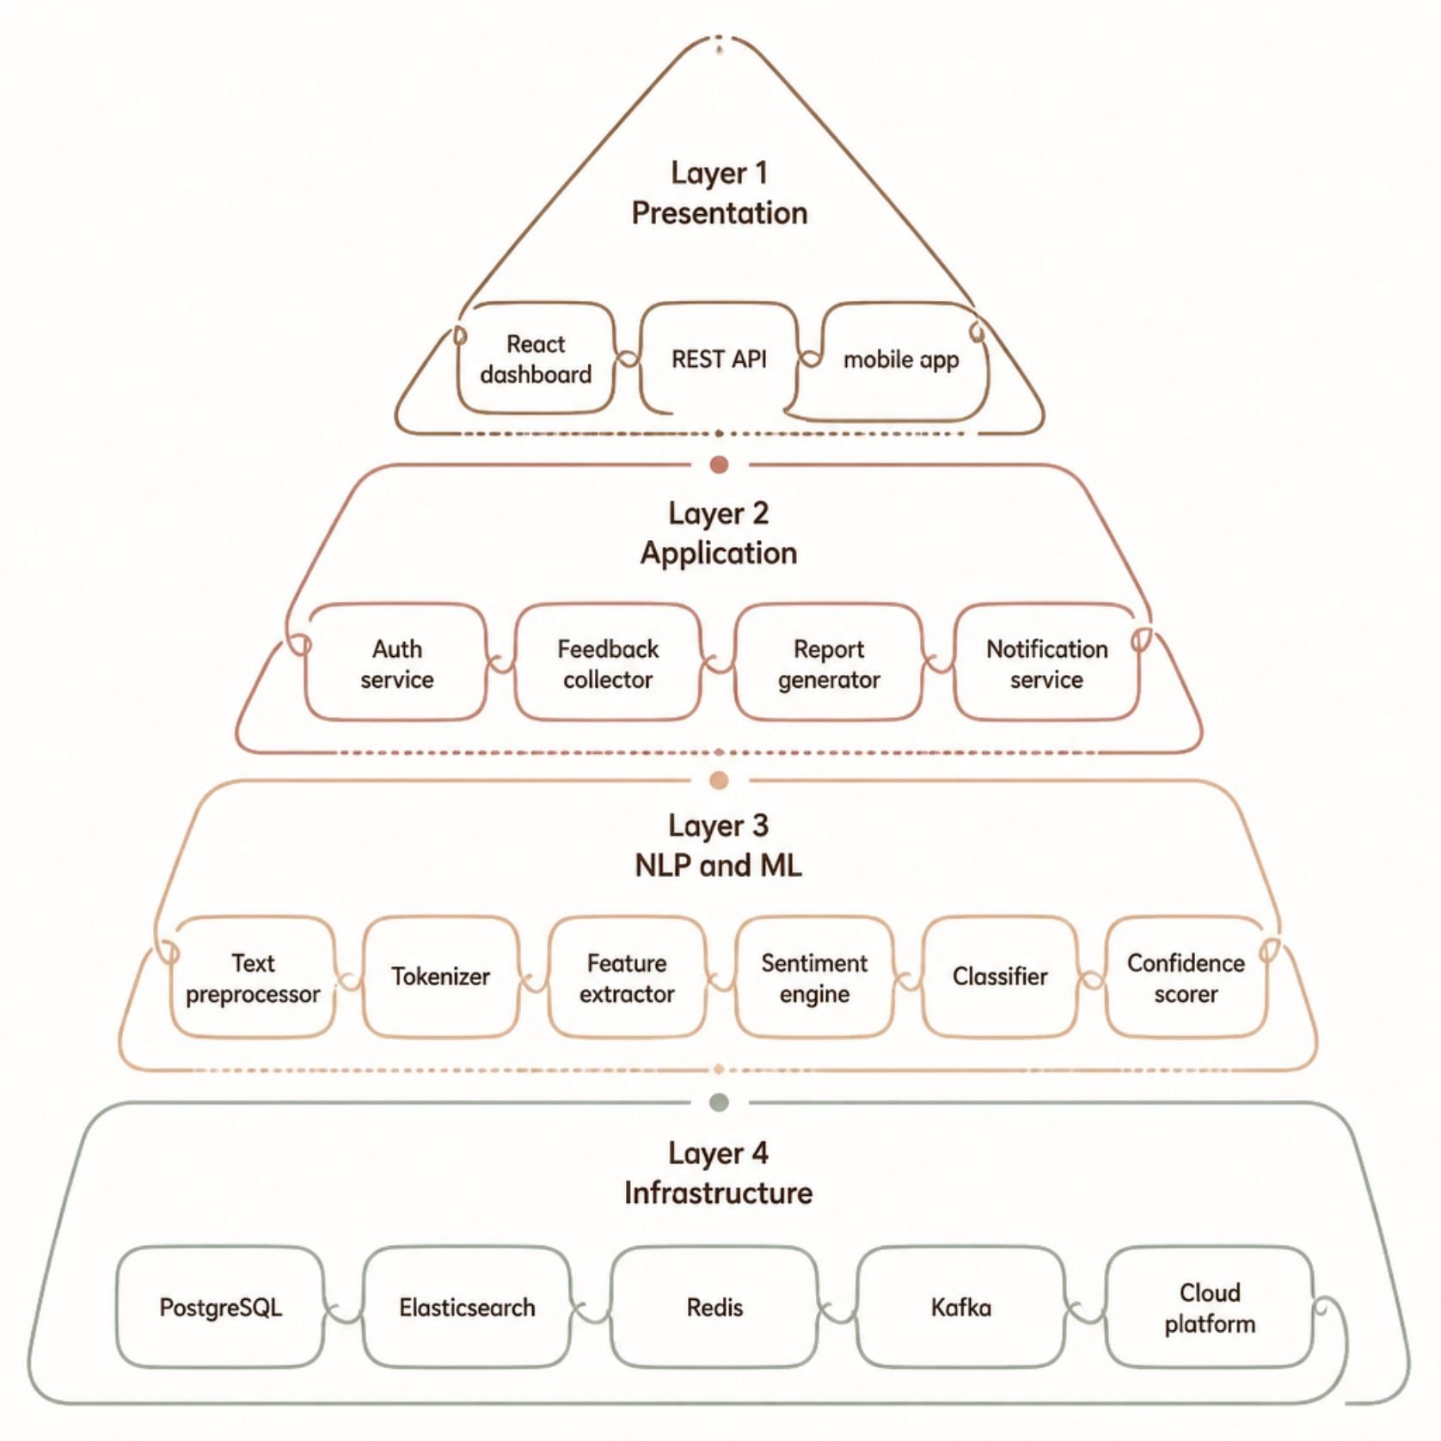
System Architecture
A layered, cloud-native architecture ensures separation of concerns, horizontal scalability, and fault tolerance across all components.
01
02
Presentation Layer
Application & Business Logic Layer
React/Angular dashboard, mobile apps, REST API gateway
Microservices for auth, feedback ingestion, reporting, notifications
03
04
NLP & ML Inference Layer
Database & Cloud Infrastructure
Preprocessing engine, sentiment model, classification service, confidence scorer
PostgreSQL, Elasticsearch, Redis, Kafka, AWS/GCP/Azure

Slide 6
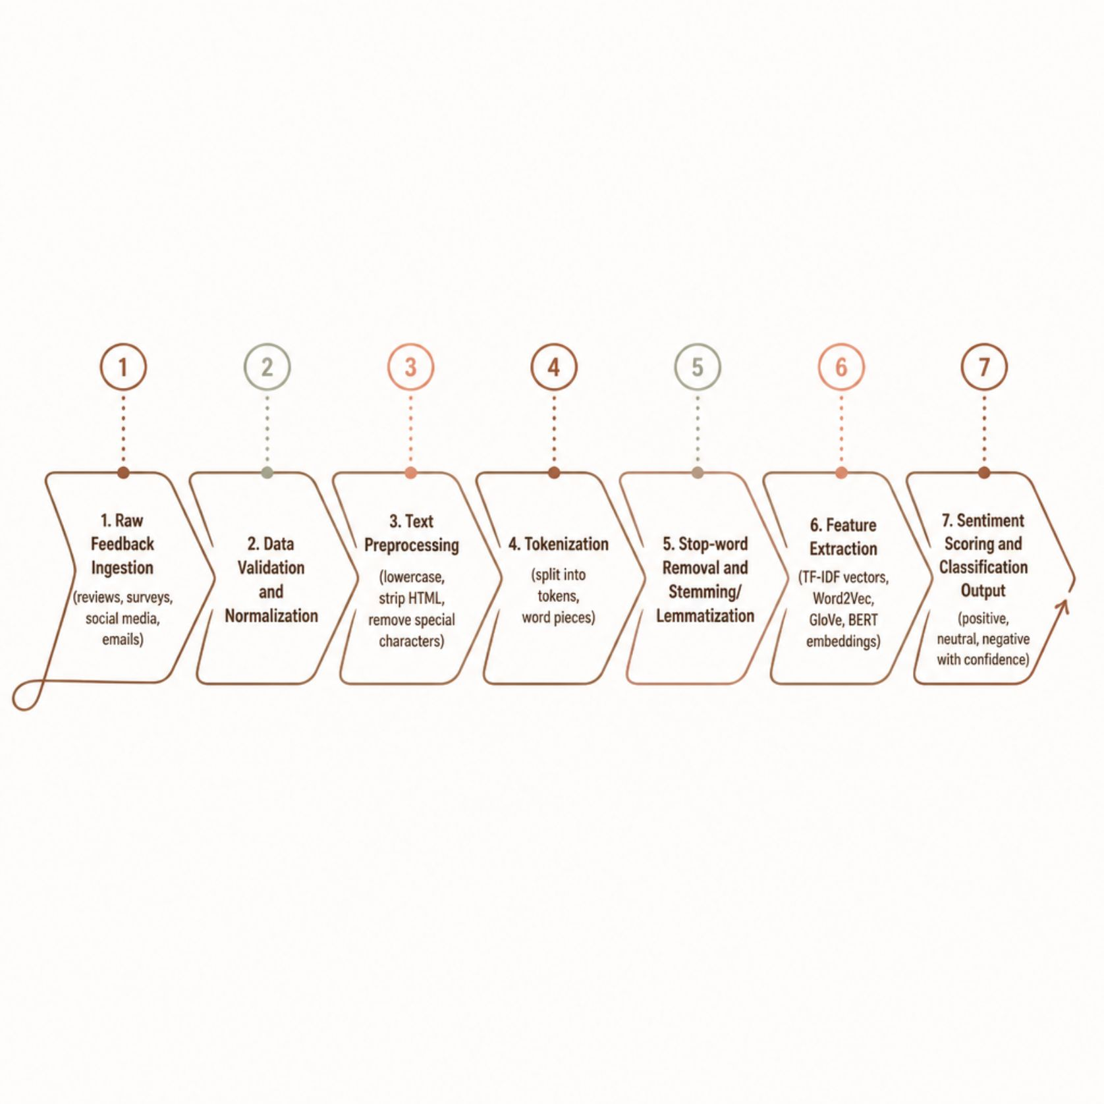
NLP Processing Pipeline
Key NLP Techniques
Tokenization: WordPiece, BPE for subword segmentation
Vectorization: TF-IDF, Word2Vec, GloVe, BERT embeddings
Feature Selection: Chi-square, mutual information, PCA
Sentiment Models: VADER, TextBlob, transformer fine-tuning
Languages: Multilingual BERT, XLM-RoBERTa support

Slide 7

Machine Learning Models & Evaluation
Classical ML
Deep Learning
Naïve Bayes, Logistic Regression, SVM, Random Forest, XGBoost — strong baselines for structured text features
RNN, LSTM, GRU networks capture sequential context and long-range dependencies in text
Transformers
BERT, RoBERTa, DistilBERT deliver state-of-the-art accuracy via transfer learning and attention mechanisms
Evaluation Metrics
94%
Accuracy
Overall classification accuracy on held-out test set
0.92
F1-Score
Harmonic mean of precision and recall across classes
0.96
ROC-AUC
Discrimination ability between positive and negative sentiment
<50ms
Latency
End-to-end inference time per feedback item

Slide 8




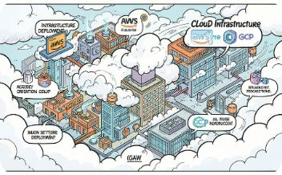
Technology Stack
Frontend
Backend
Data Layer
NLP & ML
React.js / Angular, D3.js, Chart.js, responsive PWA
Python, FastAPI / Flask, Node.js, gRPC microservices
PostgreSQL, Elasticsearch, Redis, Apache Kafka
spaCy, NLTK, Hugging Face Transformers, TensorFlow, PyTorch, Scikit-learn
Cloud & DevOps
AWS / GCP / Azure, Docker, Kubernetes, CI/CD pipelines

Slide 9

Real-World Applications & Key Benefits
Industry Applications
Core Advantages
E-Commerce & Retail: Product review sentiment, return reason analysis
Healthcare: Patient satisfaction surveys, complaint triage
Banking & Finance: Branch experience feedback, digital banking NPS
Hospitality & Travel: Hotel and airline review monitoring
EdTech & SaaS: Course ratings, feature request prioritization
Telecom: Network quality complaints, churn prediction signals
Automated analysis eliminates manual review bottlenecks
Real-time insights enable faster, data-driven decisions
Centralized analytics unify feedback across all channels
Scalable deployment handles millions of feedback items daily
Improved retention through proactive issue resolution

Slide 10
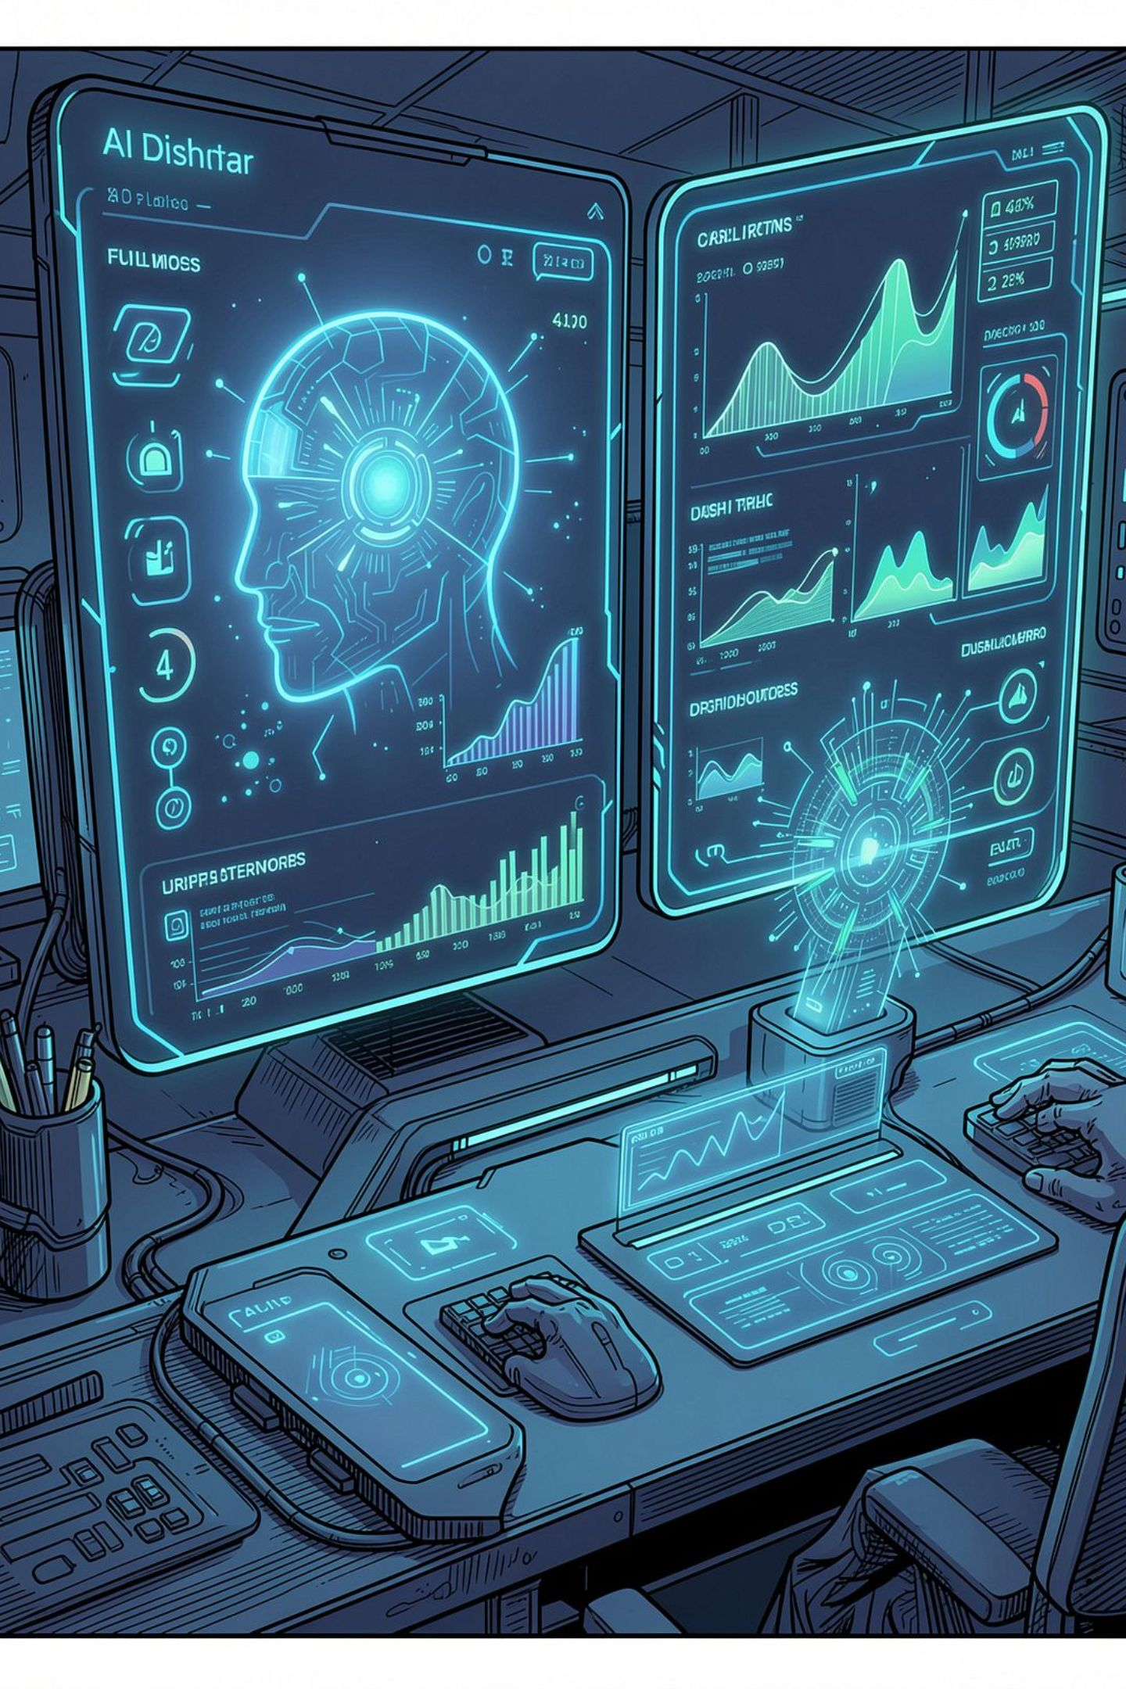
Challenges, Future Roadmap & Conclusion
Current Challenges
Future Enhancements
Sarcasm, irony, and contextual sentiment detection
Multilingual and code-mixed feedback processing
Class imbalance and domain adaptation
Customer privacy and GDPR compliance
Aspect-based sentiment analysis and emotion detection
Explainable AI (XAI) for transparent predictions
Voice feedback analysis and chatbot integration
Predictive churn modeling and CRM integration
Conclusion
This system leverages NLP and ML to automatically classify customer satisfaction, turning unstructured feedback into a strategic asset — enabling faster decisions, better experiences, and measurable business growth.

